Slide 1

D.Krishna sai Manikanta
M.V.Malleswara Reddy

Slide 2
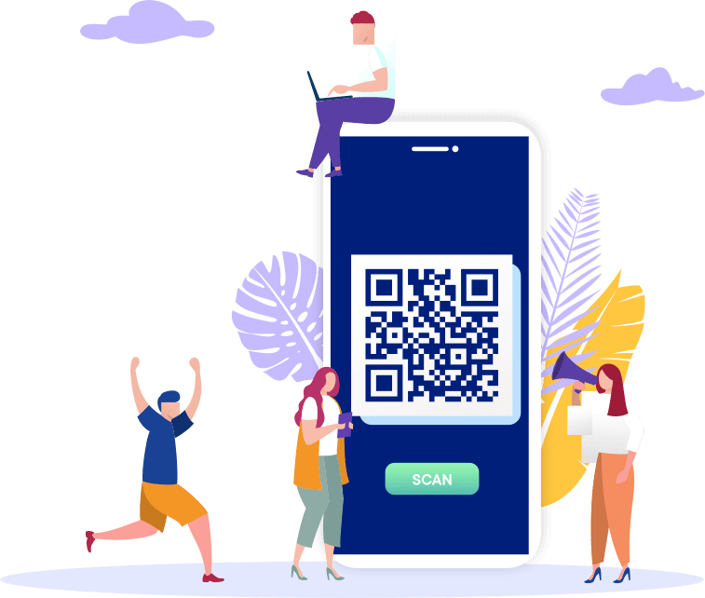
WHAT IS PAYMENT GATEWAY?
In simple terms, a payment gateway is a network through which our customers transfer funds to us. Payment gateways are very similar to the point-of-sale terminals used at most brick and mortar stores. When using a payment gateway, customers and businesses need to work together to make a transaction.
A Payment gateway plays the role of a third party that securely. transfers your money from the bank account to the merchant’s payment portal

Slide 3
HOW DOES A PAYMENT GATEWAY WORK?
Step 1: A user fills the details and clicks the pay button on th website.
Step 2:Once this happen, the website takes the user to a payment gateway where he or she scans the QR code.The PG then take the user directly to the page of the issuing bank or a 3d secure page, asking for the transaction to be authorised.
Step 3:Once the payment gateway gets the approval for the transaction, the bank then checks whether the user has sufficient balance in the account to make this transaction a success or not.
Step 4:The payment gateway sends a message to the merchant accordingly. If reply from the bank is a “NO”, then the merchant subsequently sends an error message to the user, telling them about the issue with the bank account. If the response is a “YES” from the bank portal, then the merchant seeks the transaction from the bank.
Step 5:The bank settles the money with the payment gateway, witch in turn settles the money with the merchant
Once this process is completed, the user gets a confirmation message of the payment.

Slide 4







APPLICATIONS USED

Slide 5
FRONT-END
Step 1:
At the 1st process we have created a front-end page with the user details of e-mail, name and mobile-no.The details help us and the user to track the details of the payment.
By filling the details page it will take the user to the next step process payment process page.
Step 2:
At step 2 it’s a payment processing page, the page having with a scanning QR code the user can pay the amount by scanning the QR code and with UPI pay.
The user must check the details before confirming the payment. The money is already fixed for the user, the user can’t change the payment money.
Step 3:
After completing the payment successfully an invoice is generated with the user details and the amount that has been paid.
Also we have provided a download button to download the receipt by the user in pdf format.

Slide 6
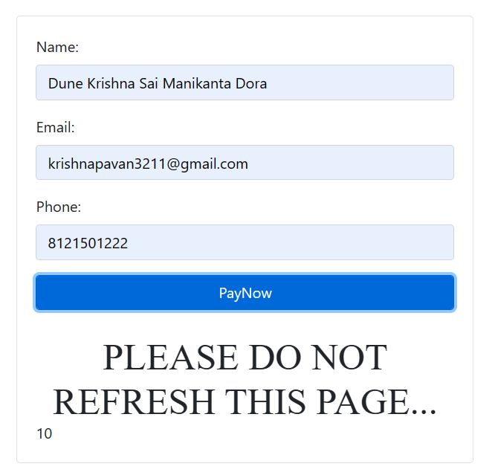
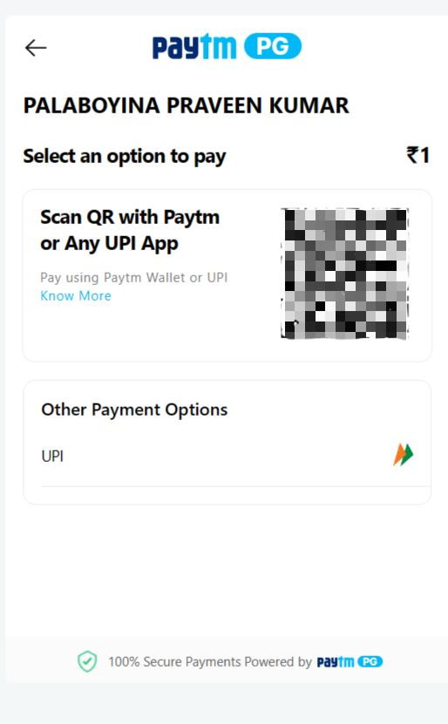
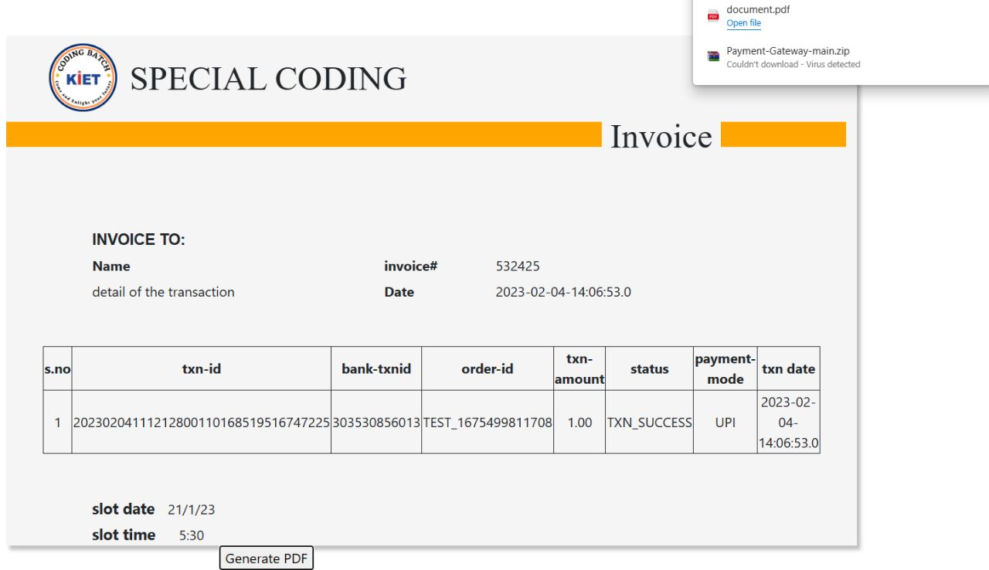
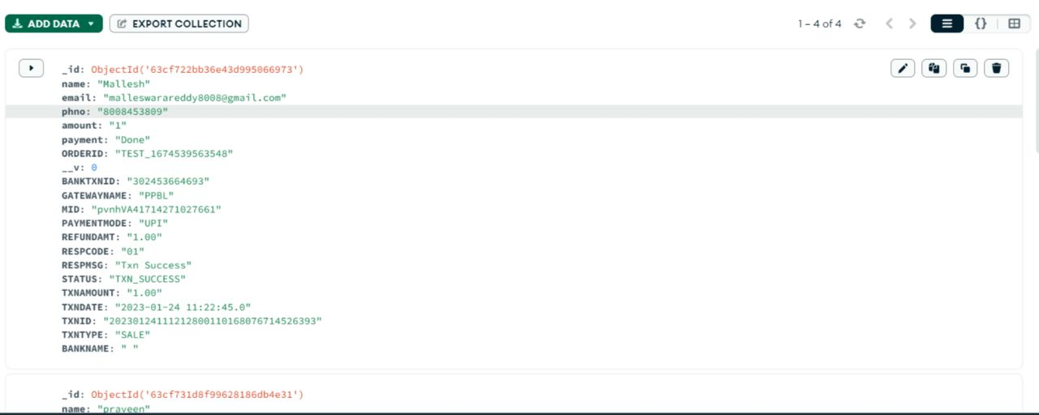
FRONT-END
Stage 1
Stage 2
Stage 3
BACK-END

Slide 7
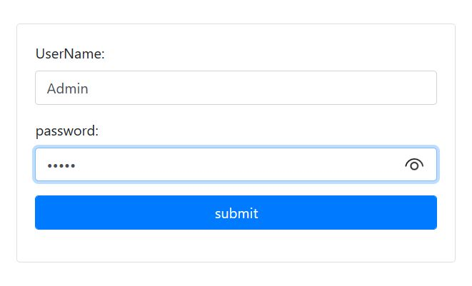
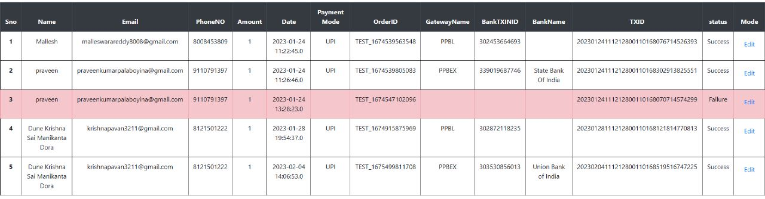
ADMIN
Stage 1
Stage 2

Slide 8
BACK-END
At the payment scanner page the payment account is connected to the paytm business account for safe and continuous transaction tracking.
In the backend process the user details that are collected from the payment page and the payment he paid will be stored in the mongodb server page safely, even the transaction failed status also stored safely end-to-end.
ADMIN
Also we have provided an ADMIN page with specific login credentials for viewing the payment details of every user. The mongo-db data is connected to the excel-sheets to download every transaction details in an excel-format by the admin3.

Slide 9
BENEFITS
Faster payments
As a business owner, we know that it is hard to get paid at all. Instead of having the hassle of agreeing to pay on a certain day and then forgetting to do so, many customers prefer to just pay instantly and get it over with. Payment gateways allow them to do just that, making it a win-win situation for both us and our customers.
Convenience
When we integrate with a payment gateway, it means that our customers can make purchases at any time.
Better security

